Slide 1
Logistic Regression
Sadia Islam Assistant Professor
Department of Computer Science and engineering United International University

Slide 2
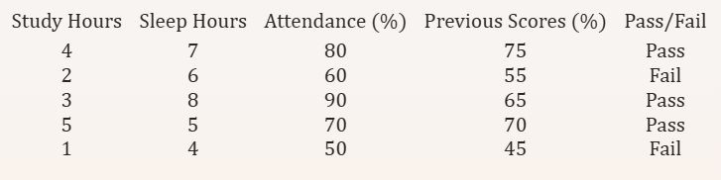
Classification
Predicting if a student will pass or fail based on features like study hours, sleep hours, attendance, and previous scores.

Slide 3
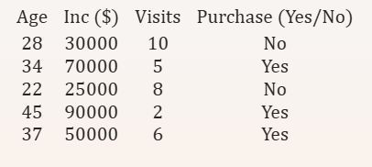
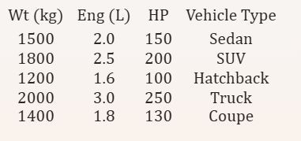
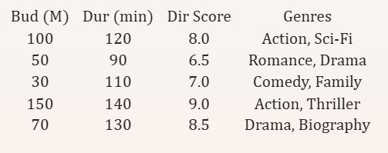
Classification
Binary-class
Multi-class
Multi-label

Slide 4
Logistic Regression
Logistic regression is a supervised machine learning algorithm used for classification tasks where the goal is to predict the probability that an instance belongs to a given class or not. Logistic regression is a statistical algorithm which analyze the relationship between two data factors.
Logistic regression is used for binary classification where we use sigmoid function, that takes input as independent variables and produces a probability value between 0 and 1.

Slide 5
Logistic Regression Assumptions
Independent observations: Each observation is independent of the other. meaning there is no correlation between any input variables.
Binary dependent variables: It takes the assumption that the dependent variable must be binary or dichotomous, meaning it can take only two values. For more than two categories SoftMax functions are used.
Linearity relationship between independent variables and log odds: The relationship between the independent variables and the log odds of the dependent variable should be linear.
No outliers: There should be no outliers in the dataset.
Large sample size: The sample size is sufficiently large

Slide 6
Logistic Regression - Binary classification task
Same procedure as regression algorithms.
In the same way, we are fitting a line like y = m₁x₁+m₂x₂+......+c, estimating m₁,m₂ etc.
Then we pass the the value of y in the logistic regression model function(sigmoid function), that is P(y=1) = 1/(1+e^{-y})
  The value of P(y=1) is the probability value of y becoming 1, ranging from 0(exclusive) to 1(exclusive).
  The value denotes the probability of any data belonging to class 1
  If P >= .5, then the instance belongs to class 1, else class 2.

Slide 7
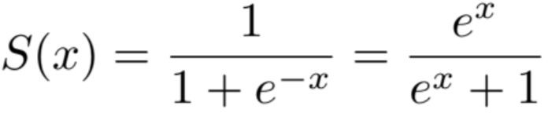
Sigmoid Function
Sigmoid is a mathematical function that takes any real number and maps it to a probability between 1 and 0. The sigmoid function forms an S shaped graph, which means as x approaches infinity, the probability becomes 1, and as x approaches negative infinity, the probability becomes 0.
The sigmoid function is a nonlinear function that is used to transform the output of the logistic regression model into a probability. An example of a sigmoid function is the logistic function,

Slide 8
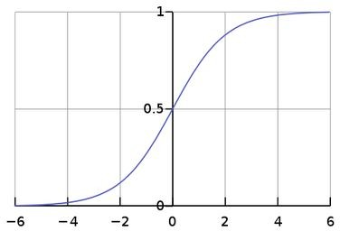
Sigmoid Function graph

Slide 9
Logistic Regression example
Binary classification task for a single input variable(x) and an output variable (y). For example, we are taking the humidity as input and trying to predict the weather condition. Suppose we have only two weather conditions as rainy or sunny.
Humidity(X) | Weather(Y) | Considering as numerical values
5 | rainy | 1
2 | sunny | 0
3.5 | rainy | 1
3 | rainy | 1
In order to generate the prediction process for next humidity values, we need to fit a line, y = mx
+ c, where the value of m and c need to be estimated.

Slide 10
Logistic Regression example
For example, after calculation we have found the value of m = -6, c = 0.1
Y = -6x+0.1
Now, for a specific value of x = 4,
Y = (-6) * 4 + .1 = 1
Passing the value to our logistic function and calculate the probability P(Y = 1) = 1/(1 + e^{–1}) = 0.732 which is > 0.5
It belongs to 1 class which reflects there is possibility of considering the as RAINY day!!

Slide 11
Types of Logistic Regression
On the basis of the categories, Logistic Regression can be classified into three types:
Binomial: In binomial Logistic regression, there can be only two possible types of the dependent variables, such as 0 or 1, Pass or Fail, etc.
Multinomial: In multinomial Logistic regression, there can be 3 or more possible unordered types of the dependent variable, such as “cat”, “dogs”, or “sheep”
Ordinal: In ordinal Logistic regression, there can be 3 or more possible ordered types of dependent variables, such as “low”, “Medium”, or “High”.

Slide 12
Multinomial Logistic Regression - Multi-class classification
Multinomial Logistic Regression is a multi-class classification method that generalises logistic regression to multi-class tasks, i.e. with more than two possible discrete outcomes of dependent variable. We can solve the multi-class classification tasks using logistic regression by employing One-vs-all (or one-vs-rest) technique.
In the One-vs-all or One-vs-Rest approach,is a method used in multiclass classification problems. It partitions a larger problem into multiple binary classification problems, simplifying the process.It splits the multi-class classification dataset into multiple binary classification datasets and fits a binary classification model on each binary classification dataset.
We train multiple binary classifiers, one for each class. Each classifier predicts whether a given sample belongs to its respective class or not.
Notes:
What is Multinomial Logistic Regression?
It's a way to classify things when there are more than two possible categories (e.g., Class 1, Class 2, Class 3). It builds on the simpler logistic regression (which works for two classes) and adapts it for multiple classes.
How does it work? (One-vs-All Approach)
One Class at a Time:
Treat each class as a "positive" (1) and all other classes as "negative" (0).
For example:
If you have Class 1, Class 2, and Class 3:
Train a binary classifier to distinguish Class 1 vs. (Class 2 and Class 3).
Then, train another binary classifier for Class 2 vs. (Class 1 and Class 3), and so on.
Run All Classifiers:
When a new data point comes in, test it on all the classifiers.
Each classifier gives a probability that the point belongs to its class.
Pick the Best Class:
Assign the data point to the class with the highest probability.
Why is it called "One-vs-All"?
Because we’re splitting the problem into smaller ones where we compare one class against all the others.

Slide 13
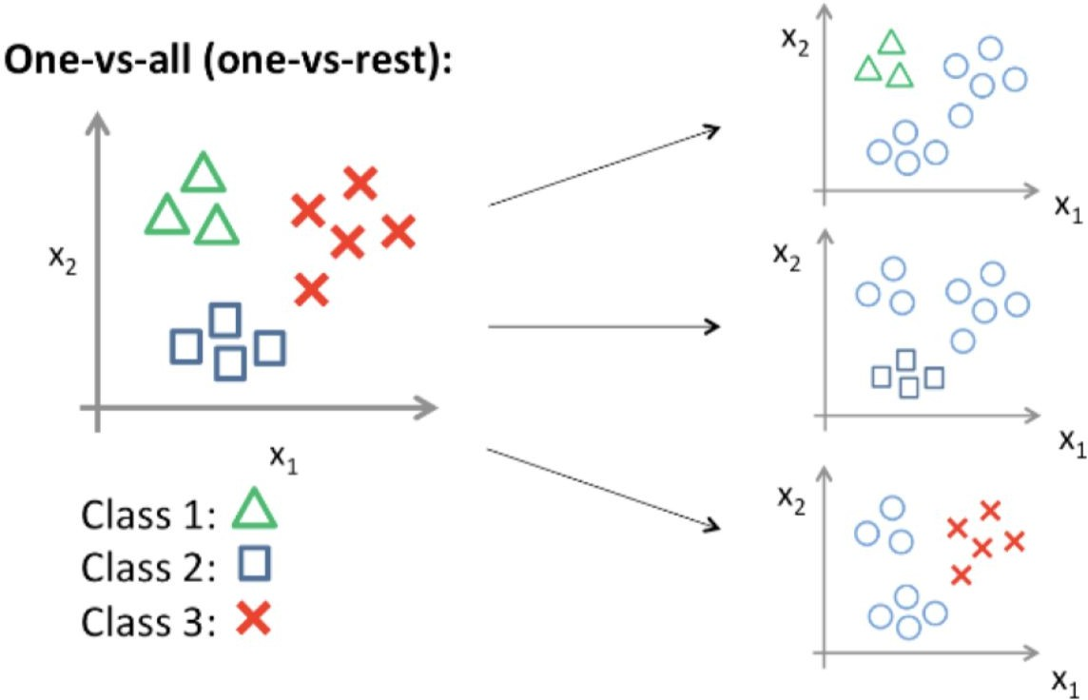
Multinomial Logistic Regression - Multi-class classification
Steps:
Train a binary classifier for each class, treating the class as the positive class(1) and all other classes as the negative class(0).
For a new sample, run it through all the classifiers.
Assign the sample to the class of the classifier with the highest probability score.
Notes:
The left side shows data with three classes (green triangles, blue squares, red crosses).
The right side shows how each binary classifier (one per class) focuses on distinguishing its class from the others.
At the end, a new sample is assigned to the class with the strongest prediction.

Slide 14
Multinomial Logistic Regression - Multi-class classification
Limitations of One-vs-all classifier:
While One-vs-all Classification is effective, it has its limitations. For instance,
  it can be computationally expensive when dealing with a large number of classes.
  Additionally, it may display lower accuracy if binary classifiers are biased or if the training data for different classes is unbalanced.

